Slide 1


IT4043E
Big Data
Storage & Processing
GROUP
4
TAXI TRIP ANALYSIS SYSTEM FOR NYC TLC YELLOW TAXI RECORDS

Slide 2



Problem Overview
Motivation & Problem Definition

Slide 3
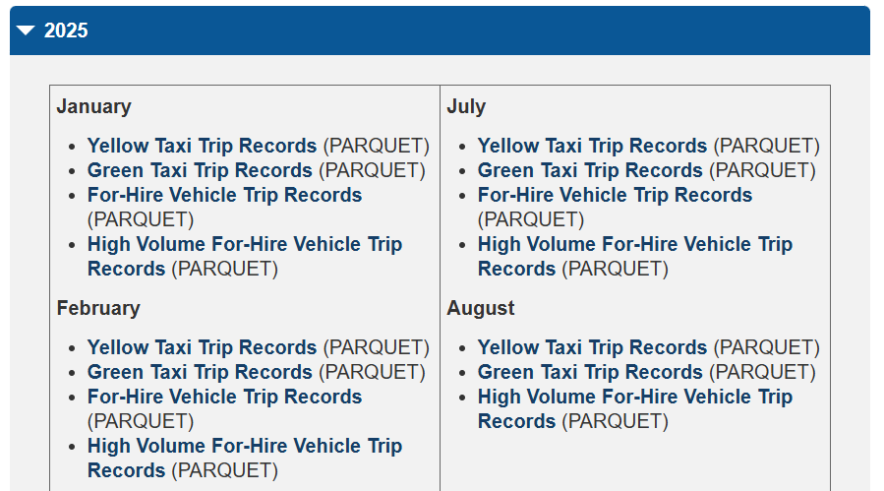
Defining features of our problem
Dataset
NYC TLC Yellow Taxi Trip Records
Millions of trips / year for 17 years (2009 – present)
Motivation
Understand city-wide taxi demand patterns
Optimize routes, fares, fleet allocation
Applying Big Data storage & processing techniques
Monthly NYC TLC Taxi Data publicly avaliable on https://www.nyc.gov/site/tlc/
Problem Definition
Design and implement a scalable data-processing architecture capable of ingesting, storing, and analyzing NYC Taxi Trip data to extract useful statistics and insights in real time or near-real time.

Slide 4
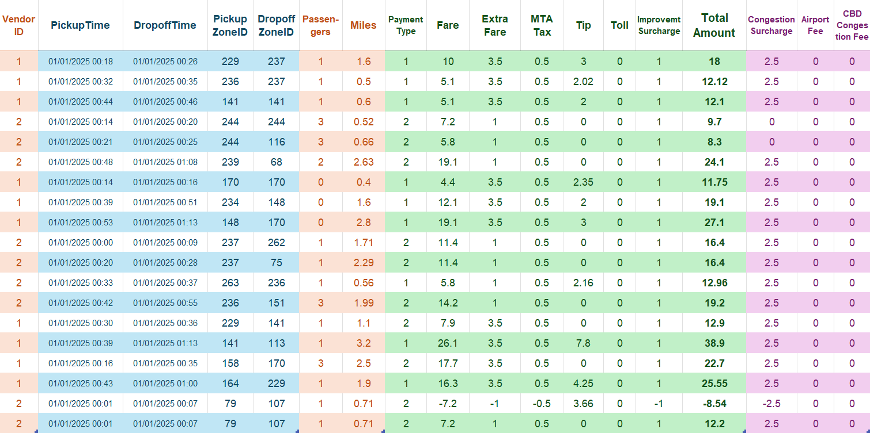
Dataset Description
Figure 2
Sample Data Points from the NYC TLC Yellow Taxi Trip Records
Pickup & Dropoff
Trip
Fares & Fees
Other Fees

Slide 5
Dataset Coverage & Qualitative Analysis
Dataset Coverage
Temporal: January 2009 – Present (by month)
Spatial: All five boroughs of New York City
Granularity: Each file (~55MB) contails millions of trip-level records
Format: Parquet files We will simulate real-time events and perform analysis on a subset of this dataset.
Qualitative Features
High volume (hundreds of millions of rows) – ideal for distributed storage like HDFS.
Continuous velocity (can simulate real-time ingestion) – fits Kafka streaming.
Diverse variety (categorical, numerical, temporal data) – good for multi-perspective analytics.
High veracity (official, regulated data) – reliable for decision-making.

Slide 6
Proposing Practical Business Questions to be Solved
Business Question | Why It Matters | Data Needed | How We Will Answer It
What are the demand patterns (pickup counts, distances, passenger counts) across time and location? | Understand traffic peaks, identify high-demand zones, support resource allocation. | Pickup timestamps, zones, trip distance, passenger count. | Aggregate trips per time window + zone → store hourly/daily summaries in Cassandra → Grafana visualizes heatmaps, time-series, top-N zones.
Which zones, vendors, or hours contribute most to revenue and profitability? | Helps identify profitable operations, surge periods, and vendor performance. | Fare amount, extra fees, vendor ID, pickup/dropoff location/time. | Spark computes revenue per zone/vendor/time window → Cassandra stores aggregated revenue tables → Grafana plots top vendors, revenue trends, and zone profitability.
Are there operational inefficiencies or anomalies (e.g., unusually long trips, delays, abnormal behaviors)? | Detects potential issues such as routing problems, driver anomalies, or unusual spikes. | Trip duration, trip distance, timestamps, potentially speed-derived metrics. | Spark flags outliers via simple thresholds (e.g., long duration per mile) → Cassandra stores anomaly counts → Grafana shows alerts, anomaly timelines.

Slide 7
Architecture & Design
Components and Data Pipeline

Slide 8


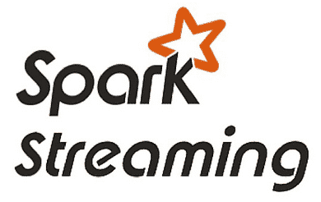




Architecture Diagram – Lambda Architecture
Source Layer
Cold Storage
Data Source
Hadoop HDFS
Speed Layer
Ingestion Layer
Serving Layer
Batch Layer
Spark Batch
Notes:
Real-Time Streaming/Ingestion Layer
This layer sits closest to the data source and is responsible for ingesting (and often buffering) large volumes of event/stream data in real time or near-real time. It decouples the producers of data from the processors, provides durability, ordering/partitioning, and makes data available to downstream systems. It also enables re-play of data, back-pressure handling, and helps provide a reliable foundation for streaming analytics. For example, you might capture clickstreams, sensor data, transactions, logs, etc. Uses of this layer:
Buffering, partitioning, persisting streaming events so they aren’t lost if downstream slows.
Providing a streaming log/topic abstraction from which processing engines consume.
Enabling multiple downstream consumers (fan‐out) or replay/debug.
Enabling ingestion from disparate sources into a unified stream platform.

Slide 9
System Components Overview
Component | Purpose
Kafka | Acts as event buffer, decouples producers from downstream processing. Enables reliable, high-throughput ingestion. Allows replaying historical data when recomputation or backfilling is required.
Spark Structured Streaming | Performs transformations, windowed aggregations, and late-data handling. Ensures correctness and flexibility across the pipeline.
Cassandra (NoSQL) | The real-time serving layer for aggregated metrics. Supports fast writes and efficient queries, powering low-latency dashboards.
HDFS | Stores raw, immutable master dataset in Parquet format for the batch layer. Enables long-term storage, historical analysis, and recomputation, ensuring system correctness over time.
Grafana | Visualization and monitoring on top of Cassandra. Enables near real-time dashboards and operational insights into key business metrics.

Slide 10

Implementation Details
A Close-up View of Each Component

Slide 11
Data Processing with Spark
Windowed Aggregations: Event-time windows (30 minutes) are used so metrics reflect when trips actually happened, not when they were processed.
Batch Ingestion to HDFS: Processed data is periodically written to HDFS (Parquet) every 30 seconds to balance freshness and efficient storage.
Late Data & State Management: A 2-hour watermark allows Spark to correctly aggregate late-arriving trips while safely discarding old state.
Exactly-Once Processing: Spark checkpoints and Kafka offsets ensure fault tolerance with no data loss or double counting.

Slide 12
Deployment & Configuration
Deployment Strategy
Multi-Stage Transformations: Streaming data is parsed, cleaned, enriched with time features, and aggregated through a structured processing pipeline.
Broadcast Join Optimization: Small static lookup tables are broadcast to workers to avoid shuffles and speed up data enrichment.
Environment-Specific Configuration
Kafka Configuration: Kafka runs in single-node mode locally and as StatefulSets in Kubernetes, with advertised listeners for internal and external access.
Spark Configuration: Spark is tuned to keep long-lived database connections, reducing overhead during high-throughput workloads.
Cassandra Configuration: Tables are ordered by recent time windows to optimize time-series queries and dashboard performance.

Slide 13
Transformations & Setup Monitoring
Advanced Transformations and Aggregations
Containerization & Orchestration: All services are containerized, using Deployments for stateless components and StatefulSets for stateful systems.
Service Networking: Kubernetes Services provide stable internal endpoints, keeping application code independent of pod placement.
Monitoring Setup
Metrics Visualization Grafana connects directly to Cassandra to display real-time business metrics.
Logging & Observability Container logs and Spark UI are used to monitor execution and debug streaming jobs effectively.

Slide 14
Demonstration
Showcasing Our Dashboard

Slide 15
Thank you!

Slide 16
Data Pipeline Summary
Stage | Input | Processing
Ingestion | TLC Yellow Taxi CSV/Parquet | Kafka producer simulates streaming
Batch Layer | HDFS (raw zone) | Spark Batch (aggregations, caching, joins)
Stream Layer | Kafka topic | Spark Streaming (watermark, UDF, window ops)
Visualization | Cassandra/HDFS | Grafana dashboard

Slide 17
Architecture Diagram
Data Source
Real-time Streaming
Serving Layer

Slide 18

Architecture Diagram – Lambda Architecture
Data Source
Speed Layer
Batch Layer
Stream
Raw Dump
Hadoop HDFS
Aggregates
Read
Spark Batch
JSON
Correct
Query
Trigger
Data Source
Scheduler
Notes:
Real-Time Streaming/Ingestion Layer
This layer sits closest to the data source and is responsible for ingesting (and often buffering) large volumes of event/stream data in real time or near-real time. It decouples the producers of data from the processors, provides durability, ordering/partitioning, and makes data available to downstream systems. It also enables re-play of data, back-pressure handling, and helps provide a reliable foundation for streaming analytics. For example, you might capture clickstreams, sensor data, transactions, logs, etc. Uses of this layer:
Buffering, partitioning, persisting streaming events so they aren’t lost if downstream slows.
Providing a streaming log/topic abstraction from which processing engines consume.
Enabling multiple downstream consumers (fan‐out) or replay/debug.
Enabling ingestion from disparate sources into a unified stream platform.

Slide 19
Dataset Description
Pickup & Dropoff
Includes Date, Time and Location (Zone ID)

Slide 20
Dataset Description
Trip Info
Includes Number of Passengers and Miles Travelled

Slide 21
Dataset Description
Fare & Fees
Includes Payment Information, Fare and various Fees

Slide 22
Dataset Description
Other Fees
Includes Miscancellaneous Fees

Slide 23
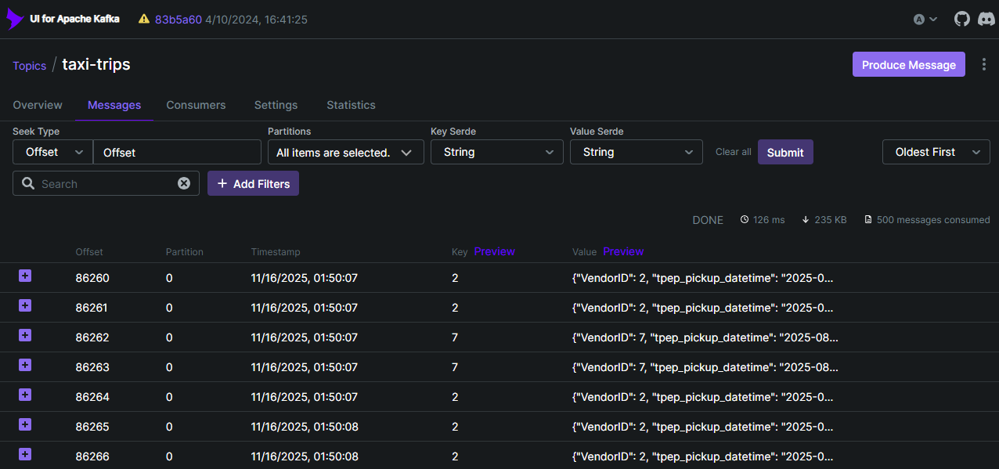
Demonstration of our Work

Slide 24
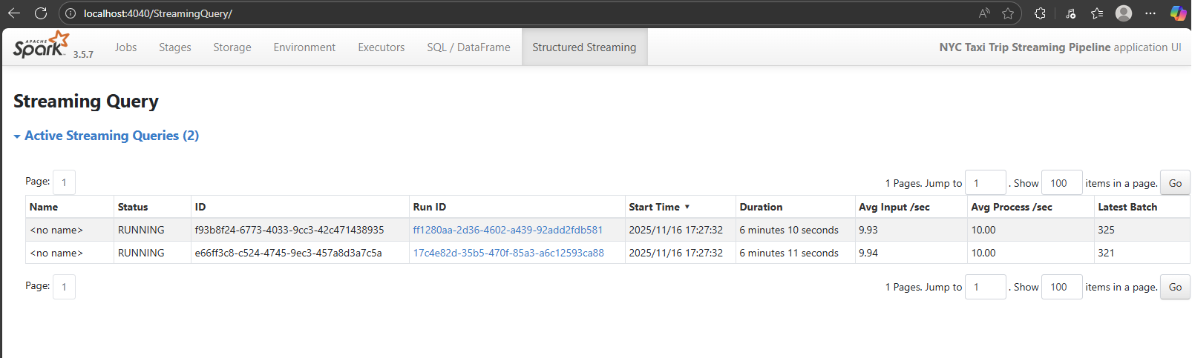
Demonstration of our Work

Slide 25
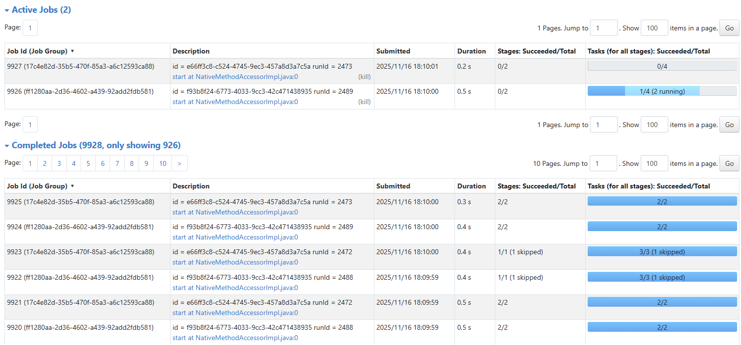
Demonstration of our Work

Slide 26
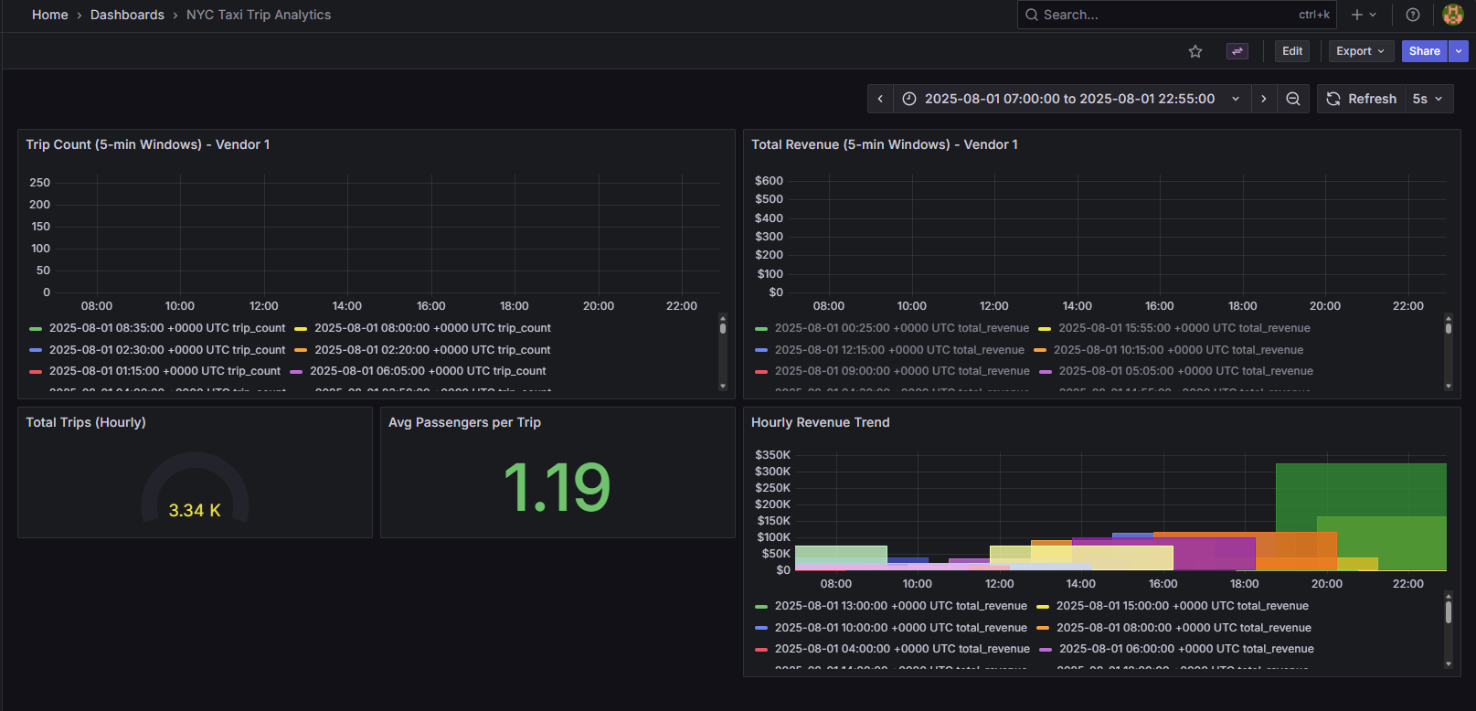
Demonstration of our Work

Slide 27
Project Progress So Far
1. Core System Infrastructure Setup
Containerized the development environment using Docker.
Configured local services to run and communicate within the Docker-based environment.
2. Data Pipeline Prototype Development
Built a minimal end-to-end working prototype of the pipeline.
Kafka: Implemented producer and consumer to simulate streaming data flow.
Spark: Conducted initial transformations to validate batch/stream processing logic.
Cassandra: Designed and tested a basic schema for storing processed records.
3. Monitoring & Visualization Setup
Created an initial Grafana dashboard to visualize pipeline metrics and output.
Integrated Grafana with the underlying data source for real-time updates.

Slide 28
Components Overview
1. Finalize Data Modeling & Integration
Define Cassandra table schemas aligned with business questions.
Implement Spark → Cassandra write pipelines (batch & streaming).
Validate schema correctness with small-scale test writes before full ingestion.
2. Expand Analytics & Aggregation Logic
Implement full aggregation workflows (revenue, demand patterns, anomalies).
Optimize Spark transformations for throughput and stability.
Add windowed aggregations and zone-level metrics based on final requirements.
3. Complete Dashboard & Visualization Integration
Connect Grafana to the finalized Cassandra datasource.
Build dynamic and drill-down dashboards for each business question.
Implement visual alerts (e.g., anomaly spikes, peak demand periods).

